Slide 1
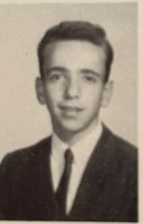
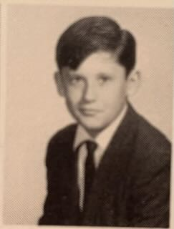
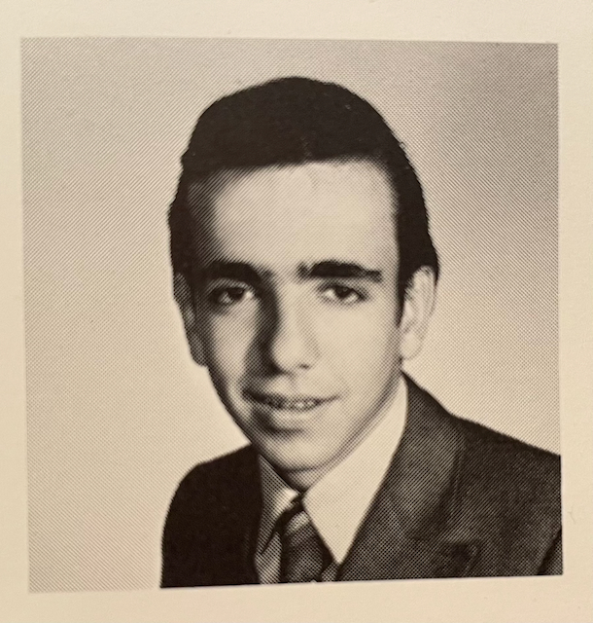
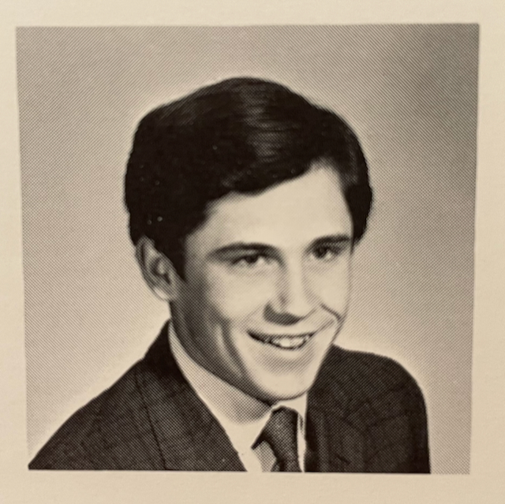
They came as Boys,
They left as Men.

Slide 2



Betty Browning

Slide 3
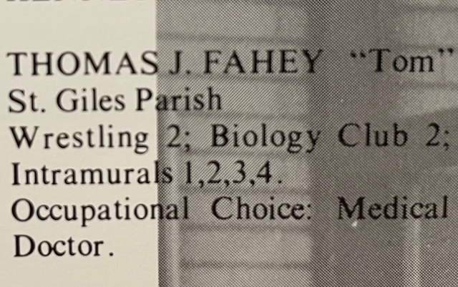
But you played one on TV!!!

Slide 4
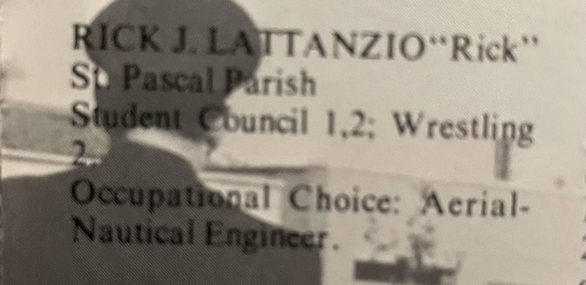
Aerial-Nautical Engineer (WTF Rick?!?!?!)

Slide 5
